Slide 1
Aggregate Abstract Form 11 & Form 11A
Presentation by:
STACEY jACOBS
Administrative Secretary
State Tax Commission

Slide 2
Aggregate Abstract Form 11 & Form 11A
County assessors are required by statute to turn over the assessment book by July 1st each year.
County clerks are required by statute to submit a Form 11 by July 20th each year.
Upon adjournment of the Board of Equalization, county clerks are required to submit a Form 11A.
Statutes allow for amendments to both Form 11 and Form 11A prior to December 31st of each year (STC prefers an amended Form 11A submission by December 15th-20th to capture changes from the BOE to end of year).

Slide 3
Aggregate Abstract Form 11 & Form 11A
Download the Form 11 / 11A file for completion from the State Tax Commission website.
https://stc.mo.gov
Clerks Tab
Commonly Used Forms Link
Form 11/11A (Excel Document)

Slide 5
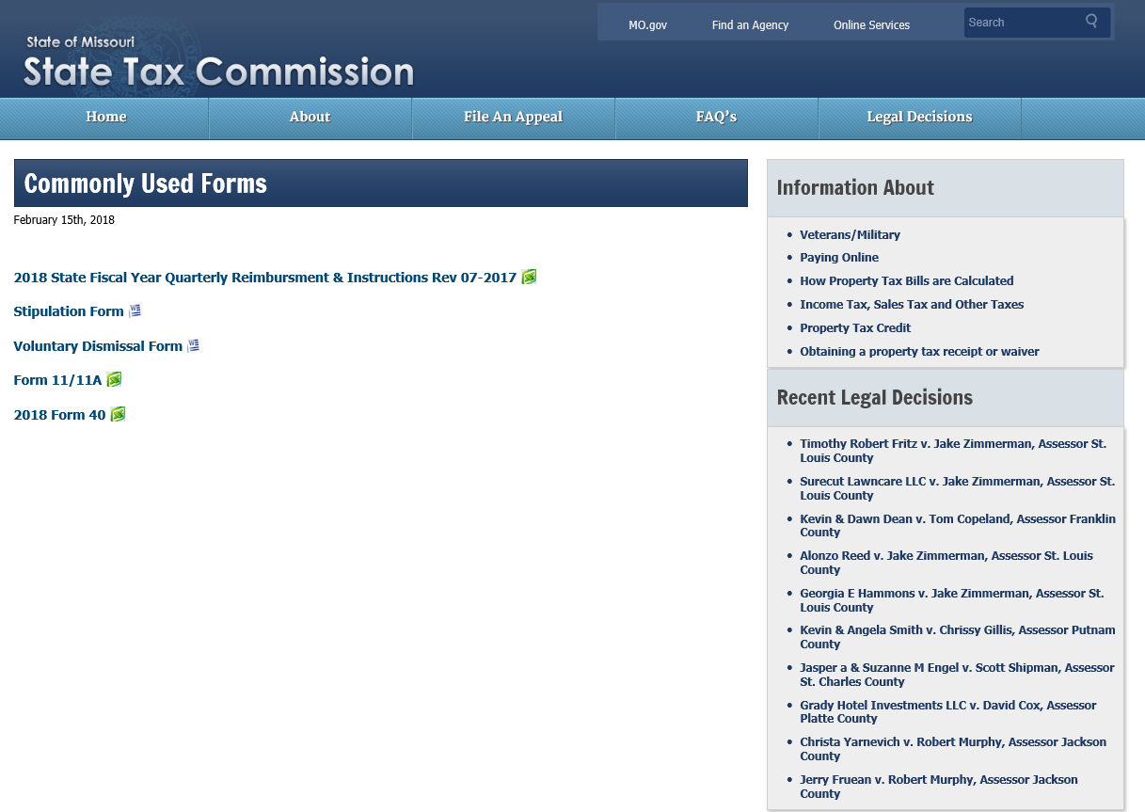

Slide 6
Aggregate Abstract Form 11 & Form 11A (Back)
Complete the back of the Form 11 or 11A FIRST
The information on the back of the Form 11 and 11A is used for reporting and auditing purposes.
There are formulas that will auto-populate the county name throughout the entire spreadsheet, if entered on the Form 11 back tab first.
Total fields in each section have formulas that will calculate the values.

Slide 7
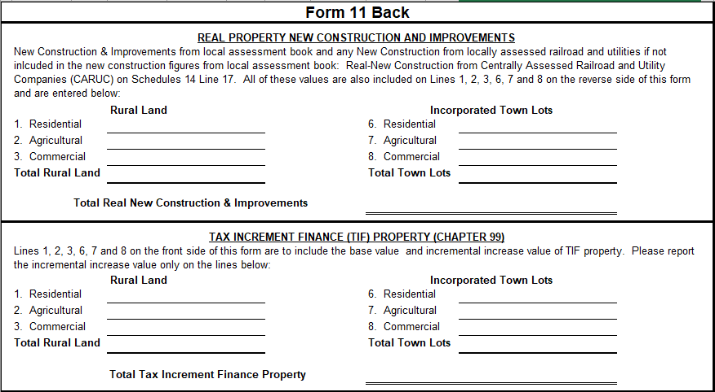
Aggregate Abstract Form 11 & Form 11A (Back)

Slide 8
Aggregate Abstract Form 11 & Form 11A (Back)
New Construction figures come from the assessor’s assessment book. The clerk is responsible for adding those figures with the New Construction from all locally assessed property of centrally assessed companies.
You will find this information on the Schedule 14, Line 17.
TIF Incremental Finance Property – Only the amount of the TIF incremental increase is reported on the back of the Form 11 and Form 11A.
Example: Base = $100 + Incremental Increase for 2016 of $200. The amount entered in TIF on the back of the form is $200 for that particular property. If the incremental increase for 2017 is $150, the amount entered in TIF on the back of the form is $350 for that particular property.
Remember – The back is for reporting purposes and both the base and the incremental increase go on the front of the Form 11 and 11A.

Slide 9
Aggregate Abstract Form 11 & Form 11A (Back)

Slide 10
Aggregate Abstract Form 11 & Form 11A (Back)
Locally Assessed REAL OPERATING Property for Centrally Assessed Railroad and Utility Companies
Includes all real OPERATING property from Schedule 14, Line 4 which should also be the figure from the Form 40 for real property total. You will have to separate the rural and incorporated town lot total values, but the grand total should match your Form 40 real property total.

Slide 11
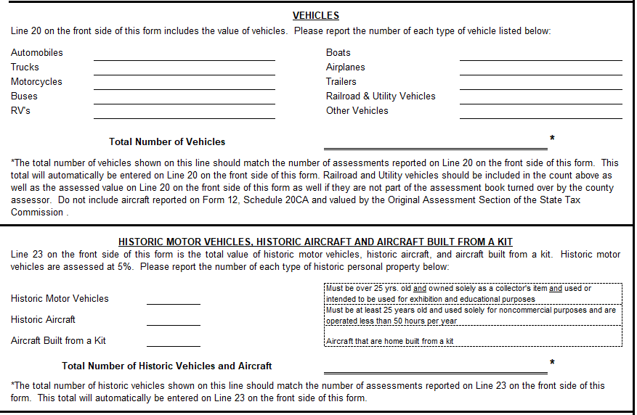
Aggregate Abstract Form 11 & Form 11A (Back)

Slide 12
Aggregate Abstract Form 11 & Form 11A (Back)
Vehicles (this block is a count of vehicles, not assessed values)
The vehicle counts will come from the assessor’s assessment book. The clerk is responsible for adding those figures with the vehicles from all locally assessed property of centrally assessed companies. Remember this total will auto-populate the Number of Assessments field, Line 20, on the front of both Form 11 and 11A.
The number of vehicles for railroad and utilities can be found on a Schedule 16 along with the assessed value for those vehicles. The assessed value for these vehicles will need to be included on the FRONT of the Form 11 and 11A.
Historical Motor Vehicles and Aircraft (this block is a count of vehicles, not assessed values)
Includes the count for all historical motor vehicles, historical aircraft, and aircraft built from a kit. The Total Number of Historic Vehicles and Aircraft will auto-populate the Number of Assessments field, Line 23, on the front of the Form 11 and 11A.
The assessed value for these vehicles and aircraft will need to be included on the FRONT of the Form 11 and 11A.

Slide 13
Aggregate Abstract Form 11 & Form 11A (Back)
Signature Block
This should be completed by the county clerk. Ensure the box is checked, which takes the place of a county clerk seal allowing for the acceptance of electronic submissions. Completing the Form 11 Back tab first will auto-populate data throughout the workbook.

Slide 14
Aggregate Abstract Form 11 & Form 11A (Front)
What goes on the FRONT of the Form 11 and 11A?
ASSESSED VALUE FOR ALL LOCALLY ASSESSED TAXABLE PROPERTY
Inclusive of Rural Electric Cooperatives and Locally Assessed Railroad and Utility Property that is NOT valued by the State Tax Commission (both operating and non-operating property).
TIF – Base and Incremental Increase
Urban Redevelopment
Enterprise Zone

Slide 15
Aggregate Abstract Form 11 & Form 11A (Front)
All locally assessed personal property
Inclusive of Rural Electric Cooperatives and Locally Assessed Railroad and Utility Personal Property that is NOT valued by the State Tax Commission (both operating and non-operating property).

Slide 16
Aggregate Abstract Form 11 & Form 11A (Front)
What does NOT go on the front of the Form 11 and 11A?
Centrally (State) Assessed Railroad and Utility Assessed Values
Chapter 100 Assessed Values

Slide 17
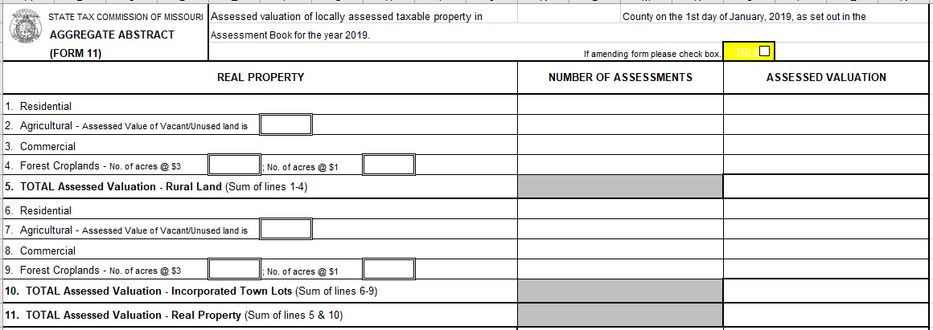
Aggregate Abstract - Form 11 (Front) Real Property

Slide 18
Aggregate Abstract Form 11 & Form 11A (Front)
Real Property Total Assessments and Values
(inclusive of Locally Assessed Railroad and Utility Property)
Residential (Rural and Incorporated Town Lots)
Agricultural (Rural and Incorporated Town Lots)
Commercial (Rural and Incorporated Town Lots)
Forest Croplands (Rural and Incorporated Town Lots)
Be sure to include the number of assessments for each subclass of property for rural and incorporated town lots.

Slide 19
Aggregate Abstract - Form 11 (Front) Personal Property (Livestock)
Personal Property Total Assessments and Values
Horses, etc.
Cattle
Hogs
Sheep & Goats
Poultry
All Other Livestock

Slide 20
Aggregate Abstract - Form 11 (Front) Personal Property

Slide 21
Aggregate Abstract Form 11 & Form 11A (Front)
Personal Property Total Assessments and Values (continued)
Farm Machinery
Vehicles – REMEMBER, the number of assessments auto-populates from the back (4th block).
Be sure to add the vehicle number of assessments and assessed values from Locally Assessed Railroad and Utility Vehicles found on Schedule 16 OR Schedule 14, Line 5 to the assessor’s assessment book (if not already included).
Grain and Other Agricultural Crops

Slide 22
Aggregate Abstract Form 11 & Form 11A (Front)
Personal Property Total Assessments and Values (continued)
Manufactured Homes - ONLY PERSONAL PROPERTY MOBILE HOMES
Historical Motor Vehicles, Aircraft and Aircraft Built from a Kit – REMEMBER, the number of assessments auto-populates from the back (5th block).
Pollution Control Tools & Equipment
All Other Personal Property (Primarily Business Personal Property)
Be sure to add the business personal property from Schedule 14, Lines 6, 7, 8, 9, and 10.

Slide 23
Aggregate Abstract Form 11A (Back)
What changes on the back from Form 11 to Form 11A?
New Construction – The residential subclass for occupancy counties should be the only change (unless there is an error or an error corrected through the BOE).
TIF – A TIF agreement has expired.
Locally Assessed Real Operating Property – The Form 40 has been amended.
Vehicles and Historic Motor Vehicles, Historic Aircraft, and Aircraft Built from a Kit – Counts should be updated, if there are any changes.

Slide 24
Aggregate Abstract Form 11A (Front)
What goes on the FRONT of the Form 11A?
All locally assessed real property, inclusive of Rural Electric Cooperatives and Locally Assessed Railroad and Utility Property that is NOT valued by the State Tax Commission (both operating and non-operating property).
All locally assessed personal property, inclusive of Rural Electric Cooperatives and Locally Assessed Railroad and Utility Personal Property that is NOT valued by the State Tax Commission (both operating and non-operating property).

Slide 25
Aggregate Abstract Form 11A (Front)
Form 11 figures auto-populate in the first column of the Form 11A.
If you amend the Form 11 after the Form 11A has been submitted, an amended Form 11A will also need to be submitted.

Slide 26
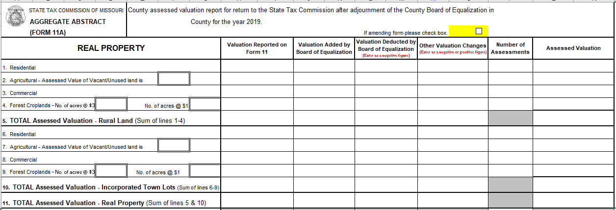
Aggregate Abstract - Form 11A (Front) Real Property

Slide 27
Aggregate Abstract Form 11A (Front)
There are 3 columns for changes made by the BOE
It is the county clerk’s responsibility to record those changes and ensure they are reported to the State Tax Commission.
BOE Column #1 – Valuation Added By BOE
Enter positive values for accurate calculation of formulas.
BOE Column #2 – Valuation Deducted By BOE
Enter negative values for accurate calculation of formulas.
BOE Column #3 – Other Valuation Changes (Court Orders, Corrections, Etc.)
Enter negative or positive values (could be either) for accurate calculation of formulas.

Slide 28
Aggregate Abstract - Form 11A (Front) Personal Property (Livestock)

Slide 29
Aggregate Abstract - Form 11A (Front) Personal Property

Slide 30
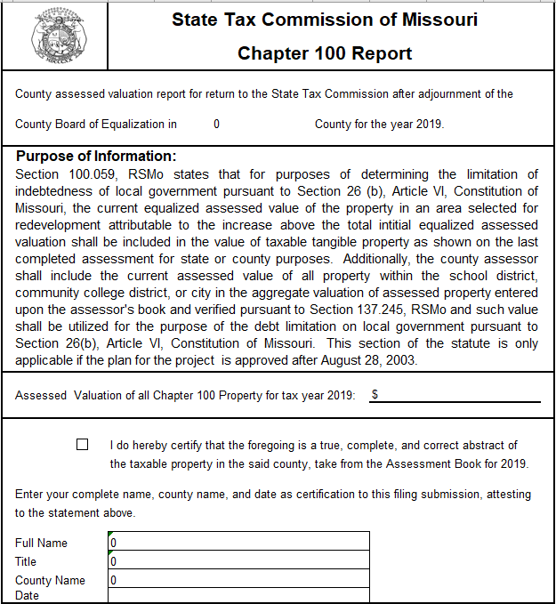
Chapter 100 Report

Slide 31
Aggregate Abstract Chapter 100
Chapter 100 assessed value does not get included on the Form 11 or 11A.
Schools are allowed to utilize the Chapter 100 assessed valuation to increase their bonding capacity
Schools are allowed to bond up to 15% of the district’s taxable tangible property
If the county assessor does not provide the information, please submit the document with a zero and indicate the assessed values were not provided by the assessor.

Slide 32
Submission of Aggregate Abstract Form 11, Form 11A, & Chapter 100
Print/save forms in PDF format for electronic submission to the State Tax Commission.
Email forms to our agency at stc@stc.mo.gov.
Contact the Administrative Secretary for county specific questions.

Slide 33
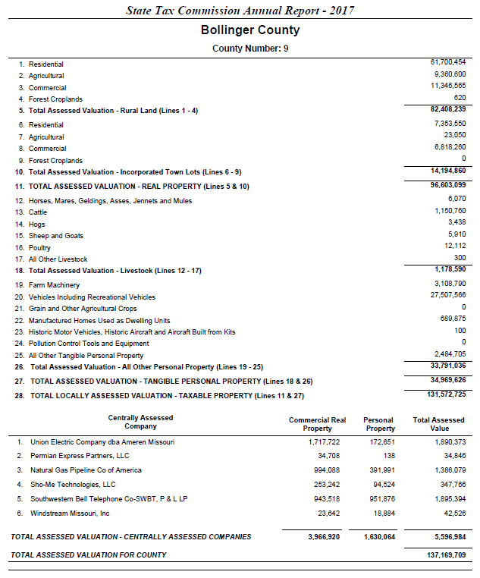
Why is it important that we keep local and centrally assessed values separate?

Slide 34
Utilization of the Form 11 and 11A Information
Missouri Association of Counties - Used for classification of counties, appropriation of membership dues, etc.
County Employee’s Retirement Fund – Utilizes the data for auditing functions
Legislative Oversight Division and Senate Research – Legislative utilizes for proposed legislation
University of Missouri – Statistical information on web site
Department of Elementary and Secondary Education – Utilizes the data as an audit function to compare with December 31st assessed valuations submitted by each County Clerk

Slide 35
Utilization of the Form 11 and 11A Information
State Auditor’s Office – Official classification of counties
Secretary of State’s Office - Publish in the Missouri Roster
Missouri State Library - Statistical data

Slide 36
Utilization of the Form 11 and 11A Information
Department of Revenue
County Aid Road Trust (CART) Funds – As mandated by Article IV, Section 30(a).1, Missouri Constitution (as amended 1979)
Approximately $110 million annually are disbursed to the counties
CART Funds are apportioned on the basis of two factors
Half of the funds are credited on the ratio a county’s road mileage bears to the total county road mileage in the unincorporated areas of the state (MoDOT)
Half of the funds are credited on the ratio that county rural land valuation bears to the rural land valuation of the entire state (STC’s final reported assessed valuations)

Slide 37
Summary
Everything goes on the front of the Form 11 and Form 11A, including operating and non-operating property of the Locally Assessed Railroad and Utility Companies
EXCEPT - CHAPTER 100 AND CENTRALLY (STATE) ASSESSED RAILROAD AND UTILITY COMPANIES
The back of the Form 11 and Form 11A are for reporting purposes only for New Construction and Improvements; TIF; and Real Operating Property of the Locally Assessed Railroad and Utility Companies
DUE DATES
Form 11 – Due by July 20th
Form 11A – Upon adjournment of the BOE
Form 11A Amendments – December 15th – 20th (to capture changes from close of BOE to end of year)
Submission of forms via email to:
stc@stc.mo.gov in PDF format

Slide 38
QUESTIONS?????

