Slide 1
STC Legal Section 2023 Spring Training Information for assessors, collectors, clerks, and boards of equalization
STATE TAX COMMISSION OF MISSOURI
Amy S. Westermann, Esq.
Chief Counsel
June 5, 2023

Slide 2
WELCOME!
STC LEGAL SECTION 2023 SPRING TRAINING AGENDA
STC’s jurisdiction and role in Missouri’s assessment process
TAFP Legislation Related to Ad Valorem Property Assessment
Court Cases to Note
Top 10 List of Things to Know for BOE Season 2023
Frequently Asked Questions

Slide 3
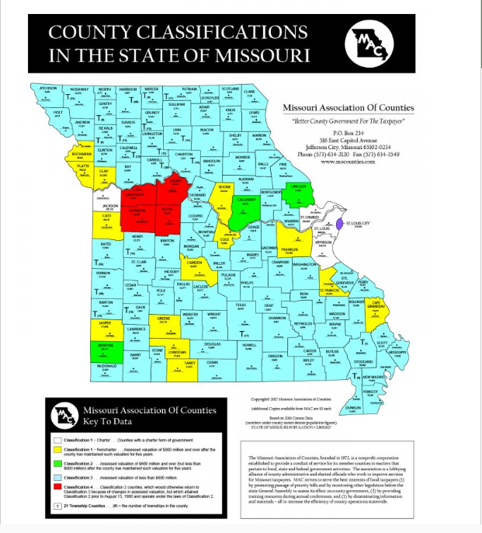
STC’s Jurisdiction & Role
Oversees assessment process.
Hears and decides appeals.
114 Counties and City of St. Louis.

Slide 4

TAFP Legislation Related to Ad Valorem Property Assessment

Slide 5
TAFP Legislation
TAX CREDIT FOR SENIORS (SB 190; Section 137.1050)
This act provides tax relief for seniors who are social security eligible as defined by the bill.
Must be 1) eligible for Social Security retirement benefits; 2) the owner of record of or have a legal or equitable interest in a homestead; and 3) liable for the payment of real property taxes on such homestead.
The amount of the property tax credit = real property tax liability on the homestead in a given year minus real property tax liability on such homestead in the year in which the taxpayer became an eligible taxpayer.
A credit granted pursuant to this act shall be applied when calculating the eligible taxpayer's property tax liability for the tax year. The amount of the credit shall be noted on the statement of tax due sent to the eligible taxpayer by the county collector.
Requires each county to adopt ordinance to allow the freeze or voters must approve through a petition initiative.
For more information, contact David Wood, STC Legislative Liaison/Policy Analyst.

Slide 6
TAFP Legislation
TAX EXEMPTION FOR PROPERTY OR PORTION OF PROPERTY USED FOR CHILDCARE FACILITIES (SJR 26; would modify Missouri Constitution Art. X, Section 6)
If approved by Missouri voters, this act would allow for both real and personal property “used primarily for the care of a child outside of his or her home” to be exempted from taxation by general law.
Also would allow the exemption for the portion of a property owned by an individual or a for profit or nonprofit corporation, organization, or association and used for such childcare.
Requires amendment to Constitution that must be approved either at the November 2024 general election or at a special election called by Governor.
General assembly would then be able to enact legislation exempting the property described.
For more information, contact David Wood, STC Legislative Liaison/Policy Analyst.

Slide 7
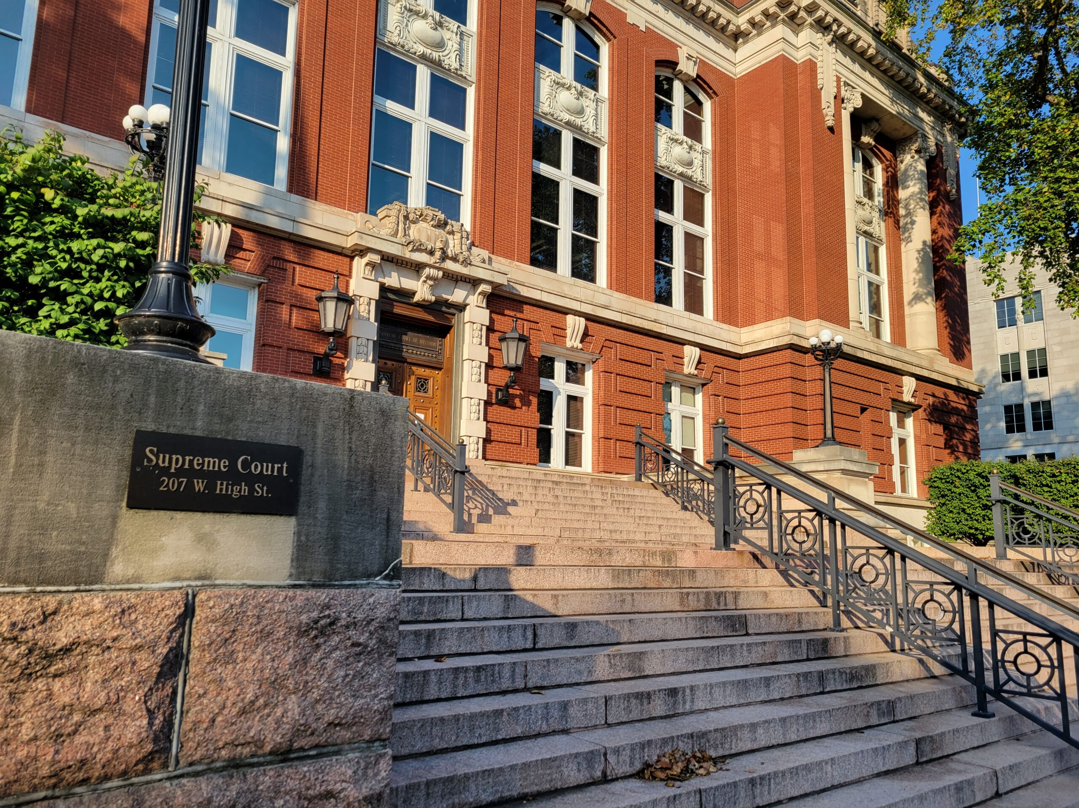
Court Cases to Note

Slide 8
SC99441 Brent Johnson, Assessor, Greene County, Missouri, et al. v. Springfield Solar 1, LLC
Legal Issue: Is Section 137.100(10) unconstitutional and void pursuant to Article X, Section 6 of the Missouri Constitution?
STC: Although taxation of property is the rule and exemption from taxation is the exception, deciding constitutional issues beyond the authority of an administrative agency.
Circuit Court: Assessor did not prove Section 137.100(10) is unconstitutional.
Supreme Court: Yes, Section 137.100(10) is unconstitutional and void.
See STC’s guidance for assessing solar property at https://stc.mo.gov/wp-content/uploads/sites/5/2022/08/Information-for-Website-Assessment-of-Solar-Property-Post-Supreme-Court-Decision.pdf
Summary:
Taxpayer appealed assessment of subject property consisting of photovoltaic solar panels mounting poles, inverters, and a concrete slab for the inverters situated on a parcel of real property leased from a municipal utility. The parcel of real property was exempt from taxation. The energy generated by the subject property was not tangible property. Taxpayer argued the subject property was exempt from taxation pursuant to Section 137.100(10); Assessor argued Section 137.100(10) is unconstitutional and void pursuant to Article X, Section 6 of the Missouri Constitution.

Slide 9

Top 10 List of Things to Know for
BOE Season 2023

Slide 10
Number 10
Assessor: conducts assessment through mass appraisal utilizing CAMA system
BOE: conducts individualized review of assessments following mass appraisal
Clerk: communicates assessed values to taxing districts for levy setting
Collector: calculates/collects taxes
STC: conducts individualized review of assessments following prior individualized review of assessments and following mass appraisal
Know your role and duties.

Slide 11
Number 10 continued
Powers of the BOE
Equalize Assessments. The BOE is to raise or lower valuations believed to have been valued below or above the real value for the property. §138.050, §138.100 & §138.150.
Hear Appeals. The BOE is required to hear complaints and appeals from the assessments made by the Assessor and to adjust, and correct the assessment accordingly. §138.060.
Determine Appeals & Keep Record. The board shall hear and determine all appeals summarily, and the Clerk is to keep a record of its proceedings. §138.060.
Add Omitted Property. If the assessor notifies the BOE of any property which has been omitted from the tax rolls, the BOE shall add and assess such property. §138.070 & §138.150.
Provide notice to the taxpayer when omitted property is added or if the existing property’s assessment is increased. If the board proposes to increase any assessment or to assess any omitted property, it shall give notice by personal notice, by mail, or if the address of the person, agent or representative is unknown, then by publication in one issue of at least two daily newspapers published within the city. §138.050, §138.070, & §138.100.
Issue Subpoenas. The board may subpoena witnesses and order the production of books and papers, and any member may administer oaths in relation to any matter within its jurisdiction. §138.040 & §138.170.
Know your role and duties.

Slide 12
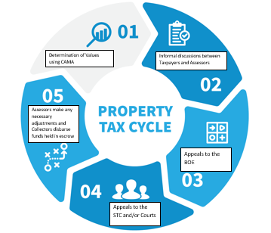
Number 9
Know the steps in the property assessment and taxation cycle.
You are here.

Slide 13
Number 9 continued
Know the steps in the property assessment and taxation cycle.

Slide 14
Number 8
Know the timeline applicable to your county’s classification.

Slide 15

Number 7
Chapter 138 RSMo. governs
Get legal advice from Board’s attorney
Appeals can be filed electronically
Hearings conducted in person or remotely or both
Issue a decision for each appeal
Know how your specific BOE operates and the terminology related to appeals.

Slide 16
Number 7 continued
Appraised Value: the property’s market value based upon one or more of the three approved approaches to determining value
Assessed Value: the property’s value on which taxes are calculated, determined by multiplying the appraised value by the statutorily-mandated assessment ratio (agricultural = 12%; residential = 19%; commercial = 32%; personal property = 33-1/3%
Burden of Proof: generally, the Taxpayer has the burden of proving his or her opinion of the property’s value is correct, but a new exception applies
Cost approach: the method of using the reproduction cost or the replacement cost of the property and subtracting depreciation to estimate value
Income approach: the method of using income and expenses and applying an appropriate capitalization rate to estimate value
Property Improvement: consists of any change to the physical characteristics of the property, whether that change is one that causes an increase or a reduction in value, but changes in zoning, neighborhood conditions or economic conditions which directly or indirectly affect the property will not warrant a change in the assessed value for the even-numbered year
RSMo: Revised Statutes of Missouri
Sales comparison approach: the method of valuing property based upon comparisons to similar properties and making positive and negative adjustments to the comparable properties to arrive at a range of values
True Value in Money or TVM: the market value of the property or what a reasonable purchaser would expect to have to pay to purchase the particular property in an arm’s-length, open-market transaction
Know how your specific BOE operates and the terminology related to appeals.

Slide 17
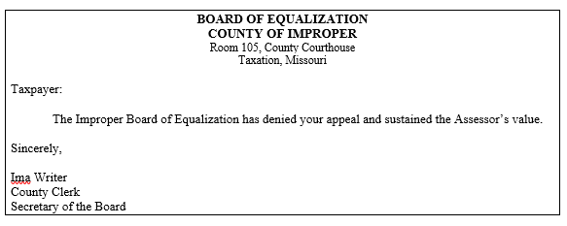
Number 7 continued
Example of an Improper BOE Decision Letter
Know how your specific BOE operates and the terminology related to appeals.

Slide 18
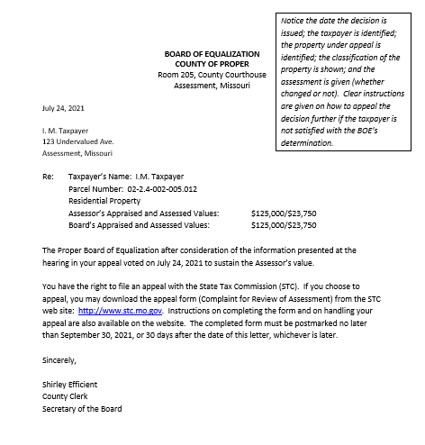
Number 7 continued
Example of a Proper BOE Decision Letter
Know how your specific BOE operates and the terminology related to appeals.

Slide 19
Number 6
“The assessed value of real property shall be calculated by determining its true value in money on January 1 of each odd-numbered year. The value shall remain the same for the subsequent even-numbered year unless there has been new construction or property improvements between January 1 of the odd-numbered year and January 1 of the following even-numbered year.”
For this BOE season, you are determining fair market value as of January 1, 2023.
Know what you are expected to determine.

Slide 20


Number 6 continued
Know what your are expected to determine.

Slide 21
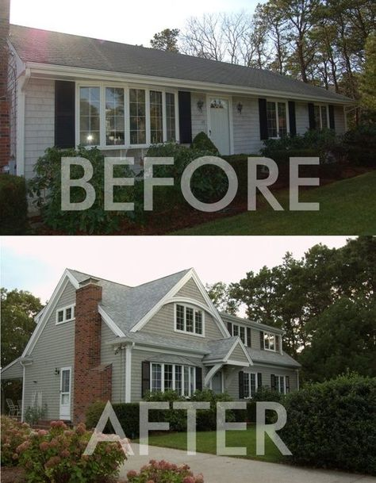
Number 6 continued
Know what you are expected to determine.

Slide 22
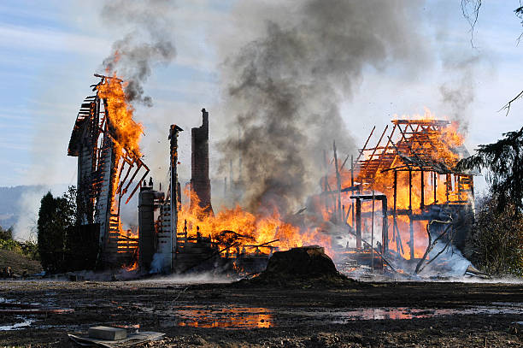



Number 6 continued
Know what you are expected to determine.

Slide 23
Number 5
Evidence of ownership to determine standing to appeal
Bids and estimates for repairs
Photographs of damage and condition
History of physical inspections by Assessor
Rent rolls and leases
Documentation of past income and expenses
Contracts and franchise agreements
Original cost and date placed in service
Know
Know which information can be relevant to determining TVM as of January 1.

Slide 24
Number 4
Know what NOT to do.
Don’t argue with the Taxpayer or the Assessor.
Don’t negotiate settlement between the Taxpayer and the Assessor.
Don’t make adjustments based on the Taxpayer’s hardship.
Don’t grant exemptions easily.

Slide 25
Number 3
Know that motor vehicles are still valued using the NADA Guide.
Section 137.115.9 provides a valuation methodology:
Average trade-in value published in the October issue of the NADA Guide or its successor publication
Other information or publications that estimate FMV may be used if no listing in NADA Guide

Slide 26
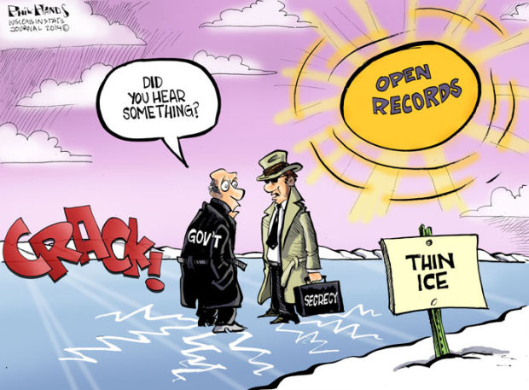
Number 2
Know that Missouri’s Sunshine Law applies to you.

Slide 27
Number 2 continued
A “public governmental body” is any legislative, administrative, or governmental entity created by the Constitution or the Revised Statutes of Missouri, by order or ordinance of any political subdivision or district, judicial entities when operating in an administrative capacity, or by executive order.
A “public meeting” is any meeting of a public governmental body at which public business is discussed, decided, or public policy formulated.
A “public record” is any record, whether written or electronically stored, retained by or of any public governmental body . . . .
A “public record” shall not include any internal memorandum or letter received or prepared by or on behalf of a member of a public governmental body consisting of advice, opinions and recommendations in connection with the deliberative decision-making process of said body, unless such records are retained by the public governmental body or presented at a public meeting. Any document or study prepared for a public governmental body by a consultant or other professional service as described in this subdivision shall be retained by the public governmental body in the same manner as any other public record.
A “public vote” is any vote whether conducted in person, by telephone, or by any other electronic means, cast at any public meeting of any public governmental body.
Know that Missouri’s Sunshine Law applies to you.

Slide 28
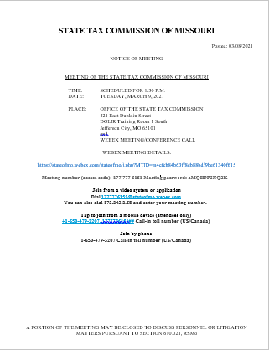
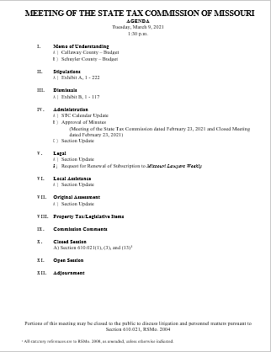
Number 2 continued

Slide 29
Number 1
Know the Golden Rule.
Treat others
the way you want
to be treated.

Slide 30
Frequently Asked Questions and Answers

Slide 31
FAQ 1
Q: How can the assessment roll be closed by July 1 if the assessor and taxpayer are continuing to have informal discussions about a possible adjustment to the assessment of property and the taxpayer has until the second Monday in July to file an appeal with the BOE?
A: The statutory deadline for closing the assessment roll is July 1. The statutory deadline for a taxpayer to file an appeal with the BOE is before the second Monday in July. If the assessor and taxpayer reach an informal agreement regarding the TVM of property after the assessment roll closes, the taxpayer should file an appeal with the BOE, and the assessor and taxpayer should present their informal agreement to the BOE. If the BOE does not approve the agreement, the taxpayer should file an appeal with the STC. The assessor and taxpayer can then enter into a stipulation that will be presented to the Commission for review and a vote.

Slide 32
FAQ 2
Q: If the BOE does not think it can hear all of the appeals before it under the timeline set by Chapter 138, can the BOE simply pass on the appeals to the STC?
A: No. The BOE is an independent body charged with determining the market value of property within the county. The BOE should review the information presented by both parties and make its own decision. If the taxpayer disagrees with the BOE’s decision, the taxpayer may file an appeal with the STC. Please note: under Missouri law, the STC does not have jurisdiction or authority over an appeal without a BOE decision, except in specifically defined circumstances.

Slide 33
FAQ 3
Q: with the expected increase in the number of appeals in our county, What can the BOE do to help the public understand the difficulty in hearing all of the appeals filed? What can the BOE do to help the public understand the reason for the value placed on property is its fair market value?
A: BOEs should consider engaging in public-facing communication that educates and explains the appeal process. If you believe you will be experiencing an unusual appeal cycle and find it necessary to make procedural changes in your process to deliver a more acceptable experience to the taxpayers in your county, remember that the BOE is a public body that must vote openly to make procedural changes – and those procedural changes still must comply with the statutes.

Slide 34
FAQ 4
Q: What does it mean for the Assessor to have the burden of proof in appeals where the property was re-assessed at 15% or more?
A: This applies to all counties and the City of St. Louis due to the enactment of SB 676 in 2020: Where the Assessor has increased the value of property by at least15% since the last reassessment, the Assessor is required to show to the BOE, through evidence, that the 2023 value placed on the property does not exceed the fair market value as of the taxation date. See Section 138.060.1.

Slide 35
For more information . . .
State Tax Commission of Missouri
Missouri State Assessors Association
Missouri Attorney General on Sunshine Law
http://stc.mo.gov/
http://www.moassessorsassn.org/
https://ago.mo.gov/missouri-law/sunshine-law
Code of State Regulations
Revised Statutes of Missouri
https://www.sos.mo.gov/adrules/csr/csr
https://revisor.mo.gov/main/Home.aspx

Slide 36
Thank you for attending!
This presentation will be posted at https://stc.mo.gov

