Slide 1

STC Legal Section Board of Equalization Training June, 2025
STATE TAX COMMISSION OF MISSOURI
Gregory Allsberry, Chief Counsel
June 2, 3, 11, 12, 2025

Slide 2
WELCOME!
AGENDA
The Basics of Missouri’s Assessment Process
Powers and Duties of the State Tax Commission
Powers and Duties of a Board of Equalization
Top 5 Things to Know When Addressing a Taxpayer Appeal
Frequently Asked Questions/Hot Topics

Slide 3




The Basics of Missouri’s
Assessment Process

Slide 4

The Missouri Constitution requires that all real and tangible personal property be assessed at a value fixed by law. By statute, that value is “true value in money” or “actual cash value” (in most cases, synonymous with market value).

Slide 5

Property is assessed at percentages of market value
Residential property is assessed at 19% of market value
Agricultural property is assessed at 12% of market or productivity value
Commercial property is assessed at 32% of market value
Personal property is assessed at 33 1/3% of market value

Slide 6
-All real property is reassessed every two years, in the odd-numbered year. Property is assessed as of January 1. Assessor creates “assessor’s book” and delivers the book to County Clerk by July 1.
-Clerk must submit an abstract of aggregate valuations, broken down by property classification, to the State Tax Commission by July 20.
-In non-charter Counties, political subdivisions must set their tax rates by September 1. In charter Counties and the City of St. Louis, political subdivisions must set their tax rates by October 1.
THIS LEAVES A VERY SMALL WINDOW OF TIME – JULY AND AUGUST – FOR BOARDS OF EQUALIZATION TO HEAR APPEALS!!

Slide 7
Powers and Duties of the
State Tax Commission

Slide 8
The Missouri Constitution requires the State Tax Commission to:
Equalize assessments
Hear appeals from local boards in individual cases
Correct any unlawful, unfair, arbitrary or capricious assessment

Slide 9

Any assessment that does not comply with statutory requirements is an unlawful, unfair, arbitrary and capricious assessment.

Slide 10

The STC is to equalize valuation of each class of property by:
ADDING to or DEDUCTING from the value of each class of property believed to be above or below its true value in money.

Slide 11
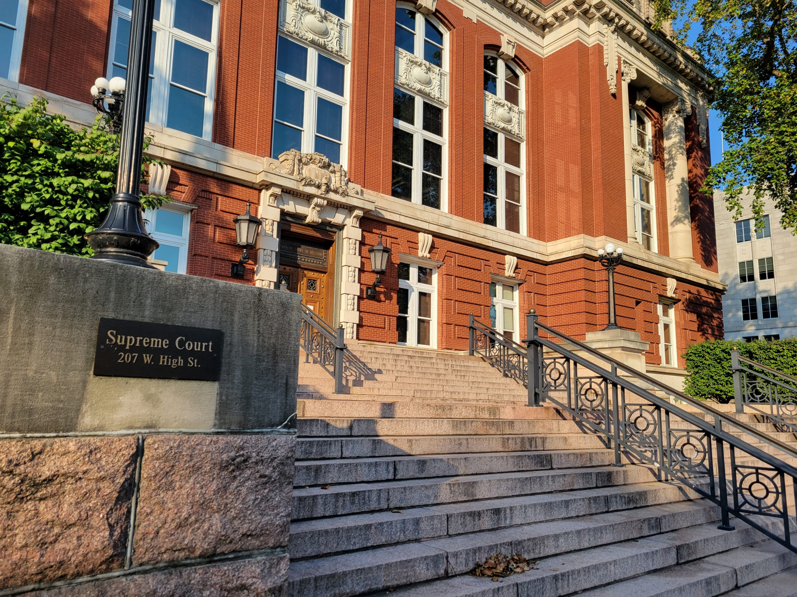
Case studies:
State ex rel. Thompson v. Bethards (1928)
State BOE ordered aggregate valuation increase of 10%
County BOE ordered aggregate valuation should not increase
County clerk stuck in the middle
Supreme Court ruled: “There can be no doubt that . . . the clerk of the county court has a duty to perform the orders of the state board of equalization.”

Slide 12
More recent court cases:
A County BOE cannot refuse to follow the STC’s blanket order equalizing value and cannot materially alter it.
May Dept. Stores v. STC, 308 SW2d 748 (Mo. 1958)
County clerk cannot refuse to apply valuation increase ordered by the STC even if the County BOE rejected the increase.
State ex rel. STC v. Briscoe, 451 S.W.2d 1 (Mo. 1970)

Slide 13
The Commission has the duty and right to exercise general supervision over all county assessing officers and county boards of equalization.
The Commission is required to enforce all laws relating to the general property tax.
The Commission has powers commensurate with its responsibility and may issue orders designed to enforce the law.
State ex rel. Cassilly v. Riney, 576 S.W.2d 325 (Mo. 1979)

Slide 14
Section 138.400.2: “It shall be the duty of the state tax commission to require of clerks of the several county commissions of this state and of the assessor in St. Louis City to keep up the aggregate valuation of real and tangible personal property in their respective counties as fixed by the state tax commission . . . “
Section 138.400.3: “In any case where the final valuation fixed by a county board of equalization . . . differs materially from the valuation fixed by the commission, such county board of equalization may be called back into session by order of the state tax commission . . . “

Slide 15
Powers and Duties of a
Board of Equalization

Slide 16
Steps in the property assessment appeal process

Slide 17
Timeline for processing appeals

Slide 18
Powers and Duties of the BOE
Equalize Assessments. The BOE is to raise or lower valuations believed to have been valued below or above the real value for the property. §138.050, §138.100 & §138.150.
Hear Appeals. The BOE is required to hear complaints and appeals from the assessments made by the Assessor and to adjust and correct the assessment accordingly. §138.060.
Determine Appeals & Keep Record. The board shall hear and determine all appeals summarily, and the Clerk is to keep a record of its proceedings. §138.060.
Add Omitted Property. If the assessor notifies the BOE of any property which has been omitted from the tax rolls, the BOE shall add and assess such property. §138.070 & §138.150.
Provide notice to the taxpayer when omitted property is added or if the existing property’s assessment is increased. If the board proposes to increase any assessment or to assess any omitted property, it shall give notice by personal notice, by mail, or if the address of the person, agent or representative is unknown, then by publication. §138.050, §138.070, & §138.100.
Issue Subpoenas. The board may subpoena witnesses and order the production of books and papers, and any member may administer oaths in relation to any matter within its jurisdiction. §138.040 & §138.170.

Slide 19
Concepts relating to property assessments
Appraised Value: the property’s market value based upon one or more of the three approved approaches to determining value
Assessed Value: the property’s value on which taxes are calculated, determined by multiplying the appraised value by the statutorily-mandated assessment ratio (agricultural = 12%; residential = 19%; commercial = 32%; personal property = 33-1/3%
Burden of Proof: generally, the Taxpayer has the burden of proving his or her opinion of the property’s value is correct, except for residential property where the valuation increased more than 15%
Cost approach: the method of using the reproduction cost or the replacement cost of the property and subtracting depreciation to estimate value
Income approach: the method of using income and expenses and applying an appropriate capitalization rate to estimate value
Sales comparison approach: the method of valuing property based upon comparisons to similar properties and making positive and negative adjustments to the comparable properties to arrive at a range of values
True Value in Money or TVM: the market value of the property or what a reasonable purchaser would expect to have to pay to purchase the particular property in an arm’s-length, open-market transaction

Slide 20
Typical relevant evidence relating to valuation
Evidence of ownership to determine standing to appeal
Bids and estimates for repairs
Photographs of damage and condition
History of physical inspections by Assessor
Rent rolls and leases
Documentation of past income and expenses
Contracts and franchise agreements
Original cost and date placed in service
Professionally prepared appraisals

Slide 21
Additional considerations:
Compensation: County commissioners, county assessor, and county clerk are not entitled to additional compensation. County surveyor and citizens who serve on the board may receive compensation if agreed by the county commission. §138.020
The BOE may not reduce the valuation of property below any value fixed by the State Tax Commission. §138.030.2
A majority of the BOE shall constitute a quorum. §138.040.2
Hearings are informal and need not be recorded, (but the clerk shall keep an accurate record of the proceedings and orders of the board.) §138.060

Slide 22
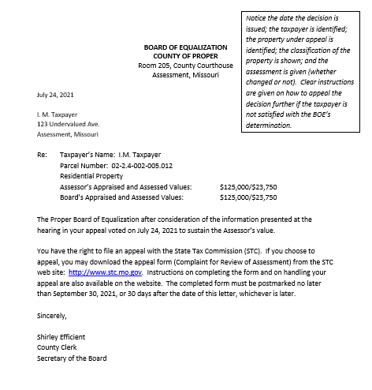
Example of a Proper BOE Decision Letter

Slide 23

Top 5 Things to Know When Addressing A Taxpayer Appeal

Slide 24

Number 1 – every property owner has the right to be heard and to present evidence.

Slide 25

Number 2 – decide appeals based upon the evidence.

Slide 26
Number 3
A “public governmental body” is any legislative, administrative, or governmental entity created by the Constitution or the Revised Statutes of Missouri, by order or ordinance of any political subdivision or district, judicial entities when operating in an administrative capacity, or by executive order.
A “public meeting” is any meeting of a public governmental body at which public business is discussed, decided, or public policy formulated.
A “public record” is any record, whether written or electronically stored, retained by or of any public governmental body . . . .
A “public record” shall not include any internal memorandum or letter received or prepared by or on behalf of a member of a public governmental body consisting of advice, opinions and recommendations in connection with the deliberative decision-making process of said body, unless such records are retained by the public governmental body or presented at a public meeting. Any document or study prepared for a public governmental body by a consultant or other professional service as described in this subdivision shall be retained by the public governmental body in the same manner as any other public record.
A “public vote” is any vote whether conducted in person, by telephone, or by any other electronic means, cast at any public meeting of any public governmental body.
Missouri’s Sunshine Law applies to you.

Slide 27

Number 4 – Don’t argue with the taxpayer or the assessor. Be courteous, respectful, and professional at all times.

Slide 28
Number 5 – if an assessor increases assessed value of residential property by more than 15%, the assessor must prove that he conducted a physical inspection of the property.

Slide 29
What constitutes a “physical inspection”?
1. The assessor must notify the owner that the assessment is projected to increase by more than 15% and that the assessor must conduct a physical inspection of the property. 137.115.10, 137.115.11.
2. The notice must be in writing and must provide clear notice of the owner’s right to request that an interior inspection be performed during the physical inspection. 137.115.11.
3. The owner shall have no less than thirty days to notify the assessor of a request for an interior physical inspection. 137.115.11 (This means that the physical inspection cannot take place until after the owner’s thirty days to request an interior inspection have elapsed.)
NOTE: THIS MEANS THAT NO MATTER HOW MANY TIMES AN ASSESSOR MAY HAVE PHYSICALLY INSPECTED THE PROPERTY BEFORE, THE ASSESSOR HAS NOT “PHYSICALLY INSPECTED” THE PROPERTY IN COMPLIANCE WITH 137.115 UNLESS THE INSPECTION OCCURS AT LEAST 30 DAYS AFTER NOTICE TO THE OWNER AS DESCRIBED ABOVE.

Slide 30
What constitutes a “physical inspection”? (continued)
4. A physical inspection shall include, but not be limited to, an on-site personal observation and review of all exterior portions of the land and any buildings and improvements to which the inspector has or may reasonably and lawfully gain external access and shall include an observation and review of the interior of any buildings or improvements on the property upon the timely request of the owner. Mere observation of the property via a drive-by inspection or the like shall not be considered sufficient to constitute a physical inspection as required by this section. 137.115.12.

Slide 31
TO SUMMARIZE:
If a physical inspection is required under 137.115:
-The assessor has the burden to prove that the assessor’s valuation does not exceed the true market value of the subject property. 138.060.1
-The assessor has the burden to establish the manner in which the physical inspection was performed. 138.060.1
IN THE EVENT THE ASSESSOR FAILS TO PROVIDE SUFFICIENT EVIDENCE TO ESTABLISH THAT THE PHYSICAL INSPECTION WAS PERFORMED IN ACCORDANCE WITH SECTION 137.115, THE PROPERTY OWNER SHALL PREVAIL ON THE APPEAL AS A MATTER OF LAW. 138.060.1
“As a matter of law” is a legal term that means GAME OVER!!

Slide 32
FAQs/Hot Topics

Slide 33
FAQ 1
Q: How can the assessment roll be closed by July 1 if the assessor and taxpayer are continuing to have informal discussions about a possible adjustment to the assessment of property and the taxpayer has until the second Monday in July to file an appeal with the BOE?
A: The statutory deadline for closing the assessment roll is July 1. The statutory deadline for a taxpayer to file an appeal with the BOE is before the second Monday in July. If the assessor and taxpayer reach an informal agreement regarding the TVM of property after the assessment roll closes, the taxpayer should file an appeal with the BOE, and the assessor and taxpayer should present their informal agreement to the BOE. If the BOE does not approve the agreement, the taxpayer should file an appeal with the STC. The assessor and taxpayer can then enter into a stipulation that will be presented to the Commission for review and a vote.

Slide 34
FAQ 2
Q: If the BOE does not think it can hear all of the appeals before it under the timeline set by Chapter 138, can the BOE simply pass on the appeals to the STC?
A: No. The BOE is an independent body charged with determining the market value of property within the county. The BOE should review the information presented by both parties and make its own decision. If the taxpayer disagrees with the BOE’s decision, the taxpayer may file an appeal with the STC. Please note: under Missouri law, the STC does not have jurisdiction or authority over an appeal without a BOE decision, except in specifically defined circumstances.

Slide 35
FAQ 3
Q: If an assessor increases all property values within a property class by a certain percentage pursuant to an mou (memorandum of understanding) between the assessor and the stc, may the boe issue an order reducing the Assessor’s values down to their original level? May the County commission do the same by ordinance?
A: No. The Missouri Supreme Court has broadly construed the STC’s supervisory authority over all matters pertaining to assessments. Failure to comply with your Maintenance Plan as reflected in an MOU will probably cost your county all of its assessment maintenance funds, and the STC may issue an Equalization Order and file suit in court to compel your compliance with the Equalization Order.

Slide 36
FAQ 4
Q: the stc voted ON JUNE 2 to order the boe in my county to remain open until the fourth Saturday in august this year. WhY?
A: On June 2, 2025, the STC voted to send orders to BOEs in 81 Missouri Counties, instructing them to remain open until the fourth Saturday in August (Aug. 23). The purpose of these orders is to allow the STC sufficient time to review each County’s Form 11 (due by July 20) and compare this year’s assessments to market values.

Slide 37
FAQ 5
Q: SO FAR THIS YEAR, THE STC HAS VOTED TO WITHHOLD ASSESSMENT MAINTENANCE FUNDS FROM 17 COUNTIES THAT REFUSED TO SIGN AN MOU. whY?
A: BY ASKING AN ASSESSOR TO SIGN AN MOU, THE STC DOES NOTHING MORE THAN ASK AN ASSESSOR TO AFFIRM THAT HE OR SHE WILL TAKE THE NECESSARY STEPS TO ASSESS PROPERTY AT OR NEAR MARKET VALUE, AS REQUIRED BY LAW AND BY YOUR MAINTENANCE PLAN. REFUSAL TO SIGN AN MOU SIGNIFIES A REPUDIATION OF THAT LEGAL OBLIGATION – IT SIGNIFIES AN INTENT TO CONTINUE TO ASSESS PROPERTIES AT BELOW MARKET VALUES INDEFINITELY.

Slide 38
For more information . . .
State Tax Commission of Missouri
Missouri State Assessors Association
Missouri Attorney General on Sunshine Law
http://stc.mo.gov
http://www.moassessorsassn.org
https://ago.mo.gov/missouri-law/sunshine-law
Code of State Regulations
Revised Statutes of Missouri
https://www.sos.mo.gov/adrules/csr/csr
https://revisor.mo.gov

Slide 39

Thank you for attending!
This presentation will be posted at https://stc.mo.gov

